Slide 1
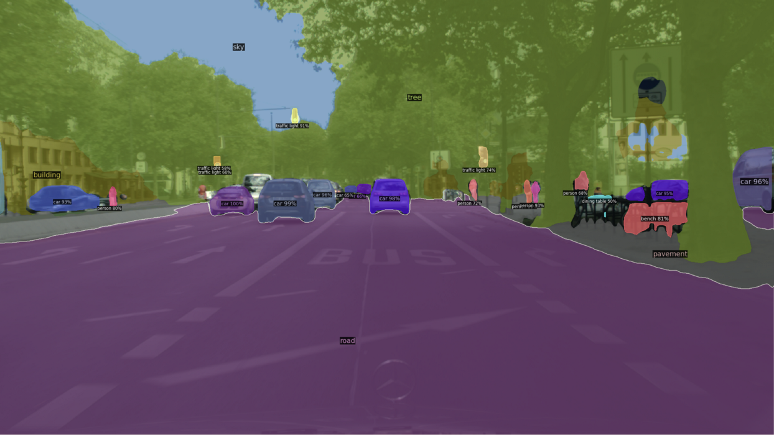
SEMANTIC SEGMENTATION –Lane Segmentation

Slide 2
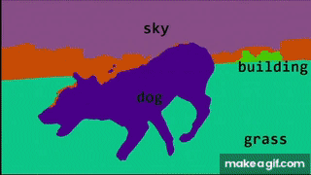
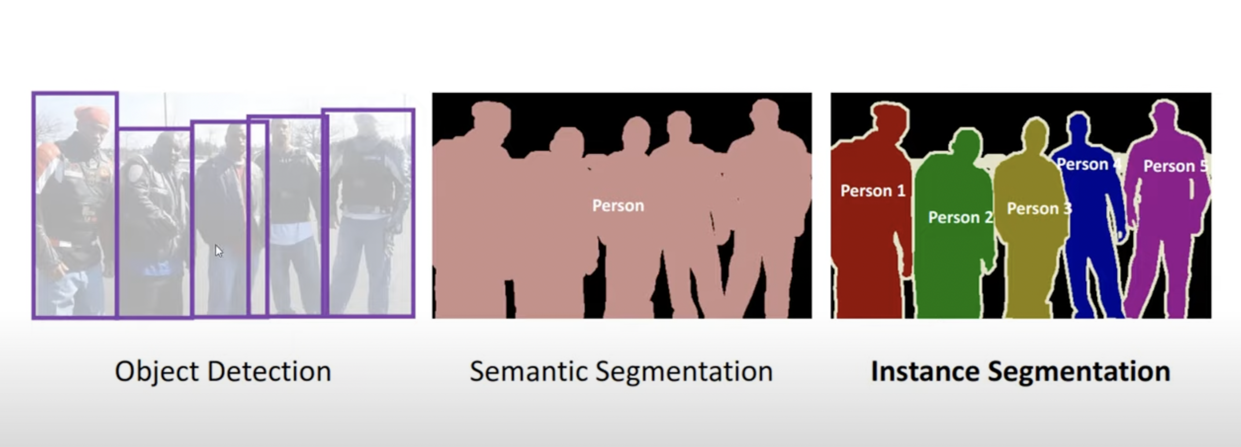
What is Image Segmentation
Method where image is broken into subgroups called Image segments
Helps reducing complexity of image
Applications
Semantic image segmentation is to label each pixel of an image with a corresponding class of what is being represented
Autonomous vehicles We need to equip cars with the necessary perception to understand their environment so that self-driving cars can safely integrate into our existing roads.
Medical image diagnostics Machines can augment analysis performed by radiologists, greatly reducing the time required to run diagnostic tests.
Notes:
All elements/pixels belonging to same category have common l

Slide 3
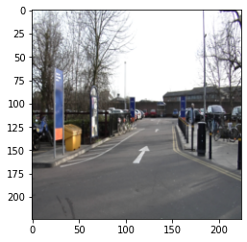
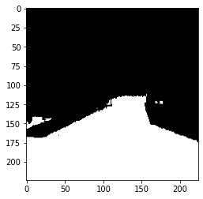
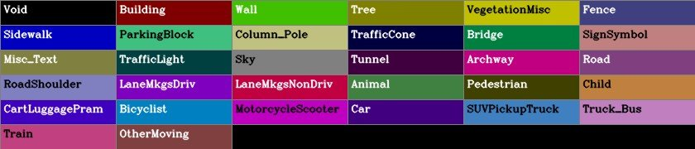
Project Objective
Collection of related computer vision tasks that involve identifying objects in digital photographs.
The Cambridge-driving Labeled Video Database provides ground truth labels that associate each pixel with one of 32 semantic classes.
The videos are from CCTV cameras and have videos of cars driving
It contains over 700 images was specified manually and was then inspected and confirmed by a second person for accuracy.
Aim is to detect and highlight lane from the given image
Notes:
The Cambridge-driving Labeled Video Database (CamVid) is the first collection of videos with object class semantic labels, complete with metadata
Over ten minutes of high quality 30Hz footage is being provided, with corresponding semantically labeled images at 1Hz and in part, 15Hz. The CamVid Database offers four contributions that are relevant to object analysis researchers. First, the per-pixel semantic segmentation

Slide 4
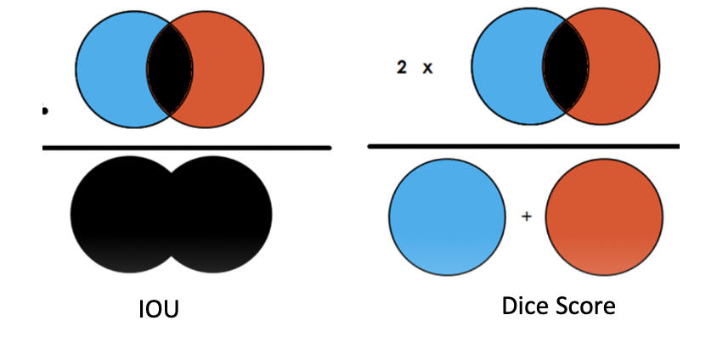
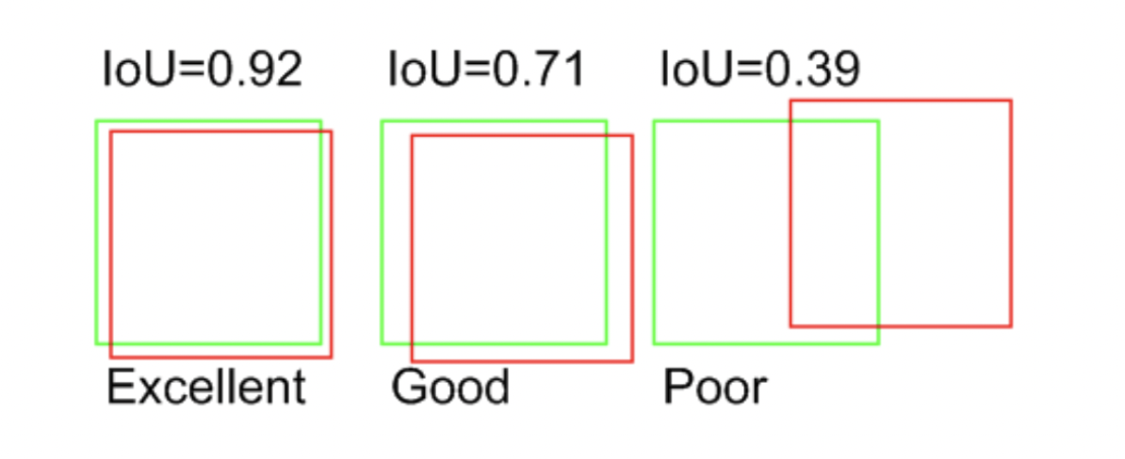
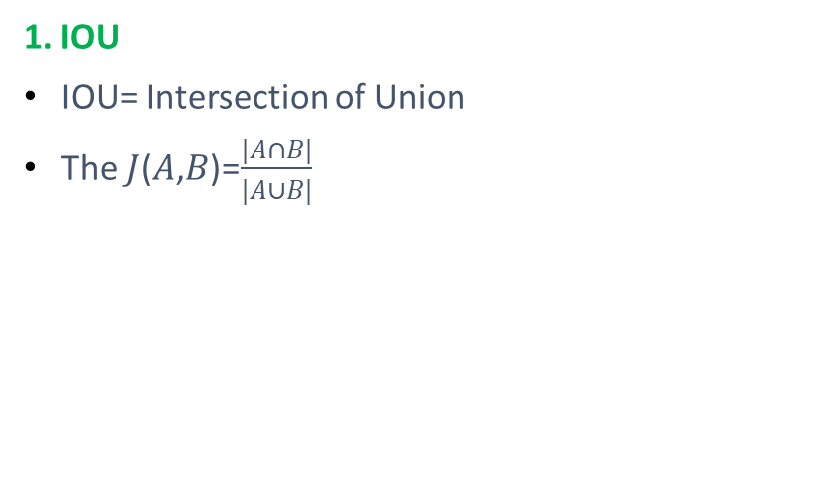
Accuracy Metric
1. IOU
IOU= Intersection of Union
The 𝐽(𝐴,𝐵)=$\frac{|A∩B|}{|A∪B|}$
2. Dice Score
2 * |X ∩ Y| / (|X| + |Y|)
Best possible value is 1 and worst possible
Is 0 for both cases
Notes:
Difference: In general, the IoU metric tends to penalize single instances of bad classification more than the F score quantitatively even when they can both agree that this one instance is bad. Similarly to how L2 can penalize the largest mistakes more than L1, the IoU metric tends to have a "squaring" effect on the errors relative to the F score. So the F score tends to measure something closer to average performance, while the IoU score measures something closer to the worst case performance.

Slide 5
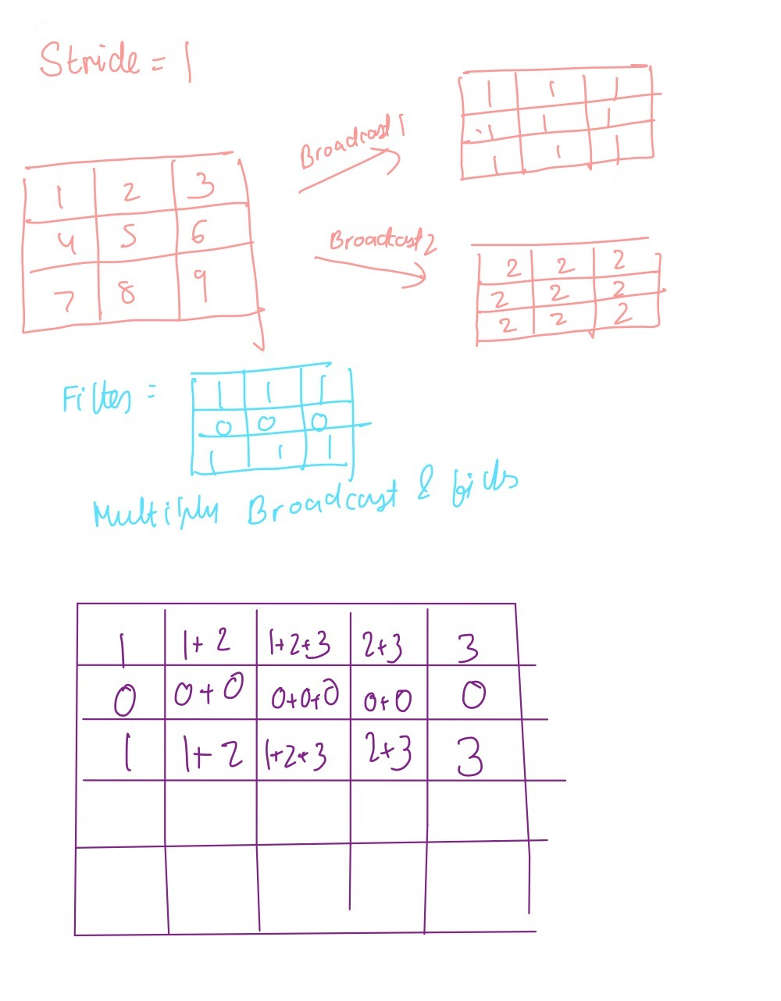
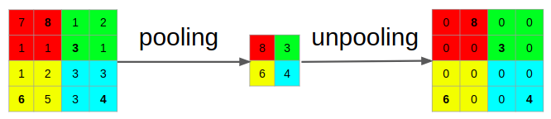
Models Applied : Base CNN
Base CNN:
1. Encoder- 2 Max Pool(size=2) and 2 convolution(num filters=65,filter size=3,stride=2,activation=“relu”)
2. Decoder – 2 Max Unpool, 2 ConvTranspose.
Notes:
Convulution-feature extraction
Unpooling and convtranspose- original size

Slide 6
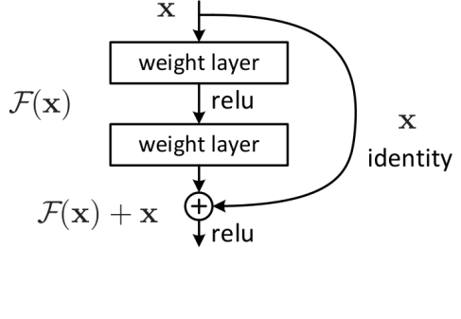

U Net
CNN that was developed for biomedical image segmentation
It’s a encoder-Decoder with Skip connections which helps solving Degredation problem
The layers in the encoder part are skip connected and concatenated with layers in the decoder part
In ResNets, the information from the initial layers is passed to deeper layers by matrix addition.
Unet(encoder_name='resnet18', encoder_weights='imagenet',classes=1,activation='sigmoid')
Notes:
3. (those are mentioned as grey lines in the above diagram). This makes the U-Nets use fine-grained details learned in the encoder part to construct an image in the decoder part.
4. This operation doesn’t have any additional parameters as the output from the previous layer is added to the layer ahead. A single residual block with skip connection looks like this:

Slide 7
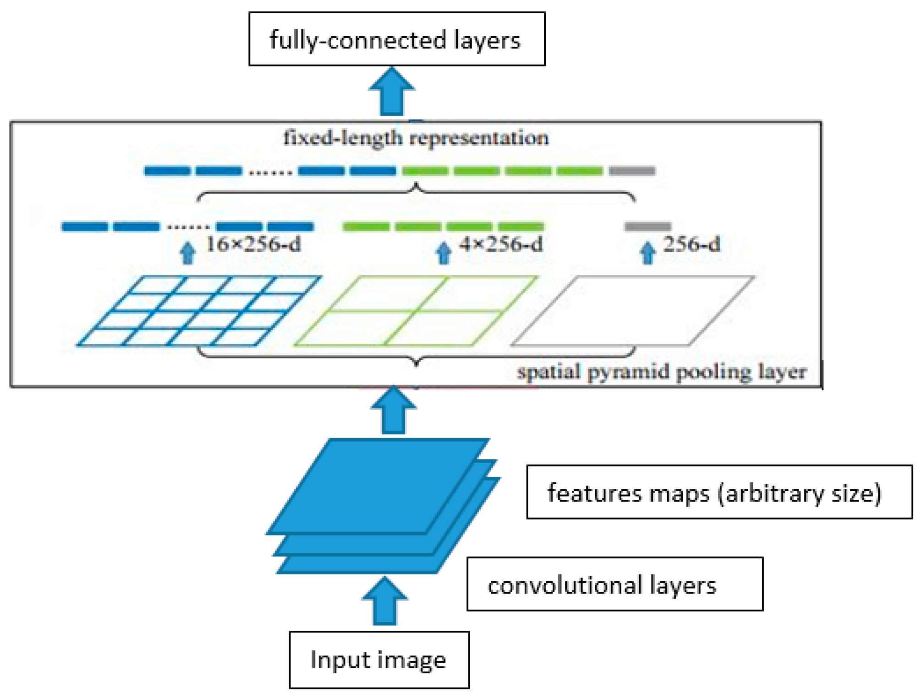
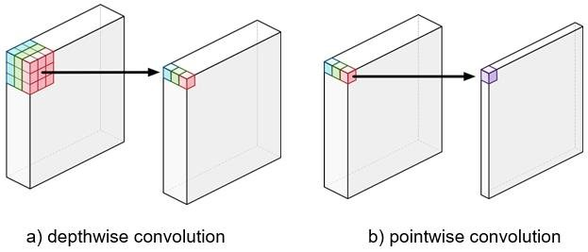
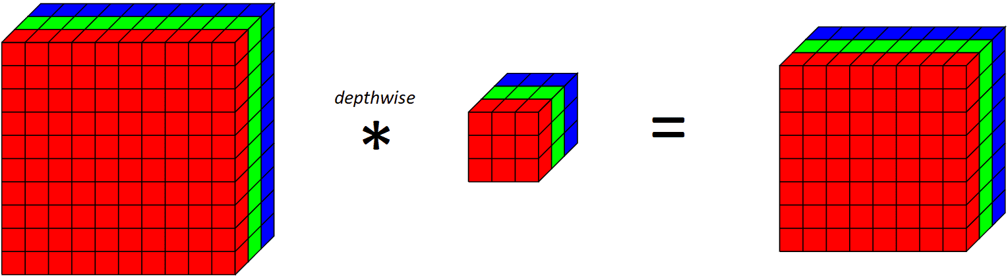
Deep Labv3
It is a Encoder Decoder Network with Depth wise separable convolution, pointwise separable convolution, spatial pyramid pooling networks
Depth wise Convolution: Separate filter for each channel of image
Pointwise Separable convolution- To increase the depth of the output, which is done by convoluting with a kernel with shape 1x1xdepth which is called a pointwise convolution.
Spatial Pyramid Pooling Network- Spatial Pyramid Pooling (SPP) is a pooling layer that removes the fixed-size constraint of the network, i.e. a CNN does not require a fixed-size input image.
Notes:
The SPP layer does “aggregation” at a deeper stage of the network hierarchy (between convolutional layers and fully-connected layers) to avoid the need for cropping or warping at the beginning

Slide 8
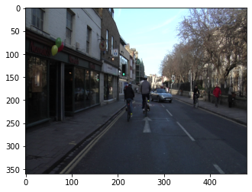
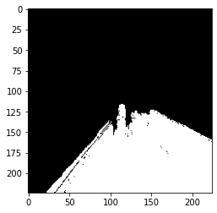
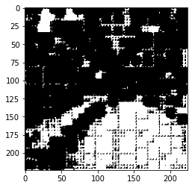
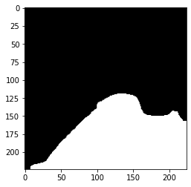
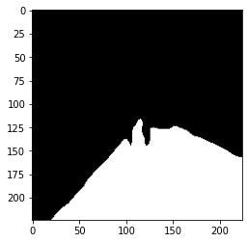
Results
BASE CNN:
IOU Score- 0.6185
Dice Score-0.6332
Training time: 3.916 sec
Testing time: 0.011 sec
Deep Lab v3:
IOU Score- 0.9084
Dice Score-0.9334
Training Time: 13.87 sec
Testing Time: 0.089 sec
U-Net :
IOU Score- 0.972
Dice Score-0.9805
Test IOU- 0.9184
Test Dice: 9351
Training Time: 5.23 sec
Testing Time: 0.022 sec

Slide 9
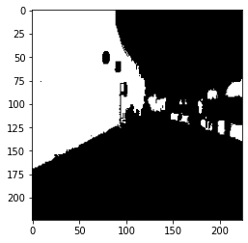
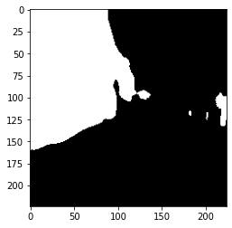
Another Application: Identifying Building using U-NET
Applying UNET-
IOU Score- 0.8556
Dice Score-0.871

Slide 10
CONCLUSION AND NEXT STEPS
CONCLUSION
We found that the U-Net Model has the best accuracy score and does a good job in identifying the lanes
NEXT STEPS:
Applying for all 32 classes and checking if accuracy decreases for different classes
Hyperparameters can be tuned more for more accuracy
U net is about 4 times faster than Deeplab v3. However fastest is Base CNN

